Slide 1

The Impact of Weather Variability on Agriculture
December 8, 2016
© Copyright 2016, aWhere. All Rights Reserved

Slide 2

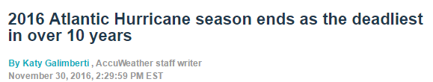
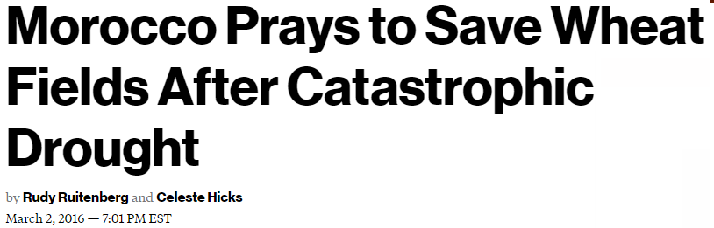
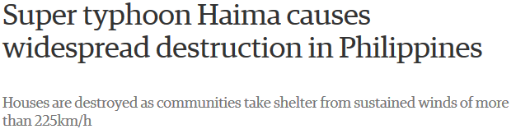
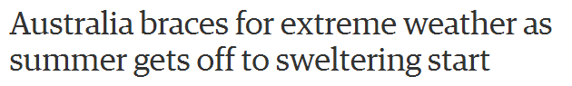
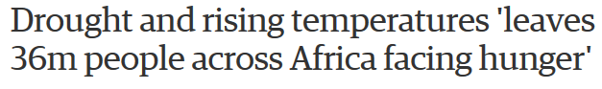
Oct 19, 2016
Mar 16, 2016

Slide 3


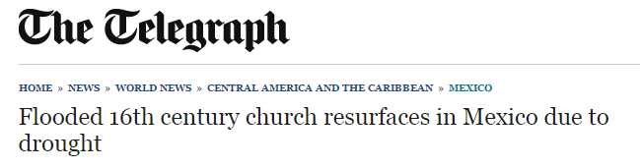
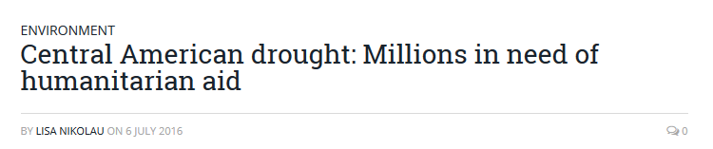
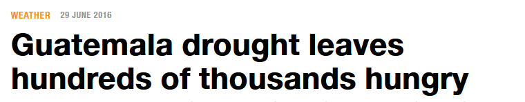

Slide 4
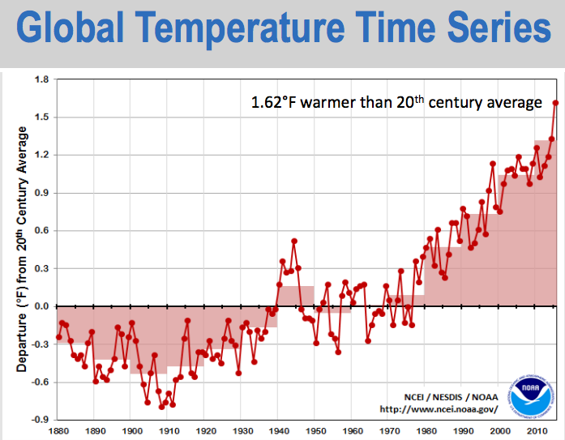
The Situation: Global Temperature and Carbon Dioxide 1880 - 2015

Slide 5
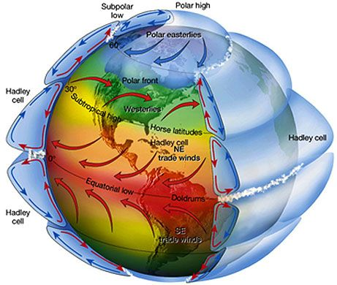
The Problem: The Earth’s Atmosphere is a Heat Engine
5.5 Quadrillion Ton Heat Engine
5.5 x 10²¹ joules (per 1°C)
Just 1°C warming of atmosphere triples weather variance
Hot gets hotter • Cold gets colder
Dry gets dryer • Wet gets wetter
Agriculture suffers, leading to
food insecurity and risk

Slide 6
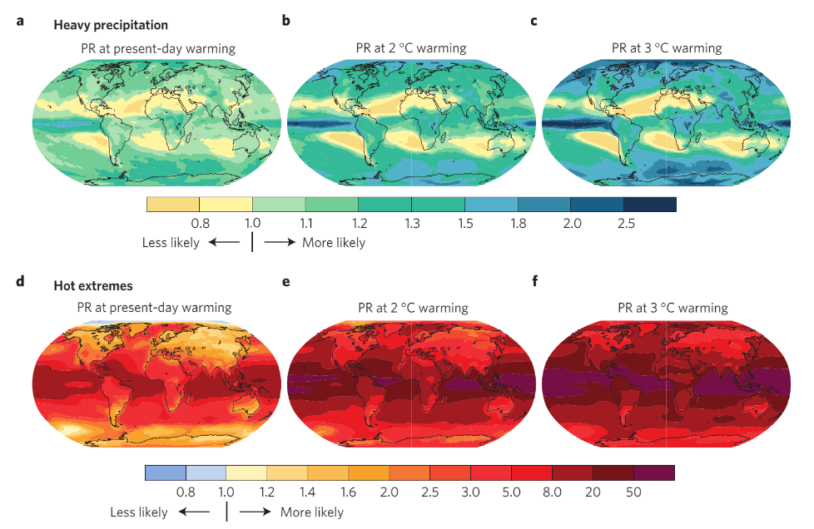
The Result: More Frequent Extreme Weather Events
E. M. Fischer and R. Knutti, “Anthropogenic contribution to global occurrence of heavy-precipitation and high-temperature extremes,” Nature Climate Change, Vol. 5 (June 2015): 563.

Slide 7
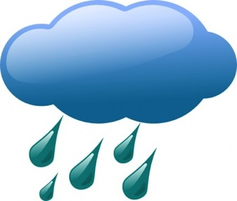
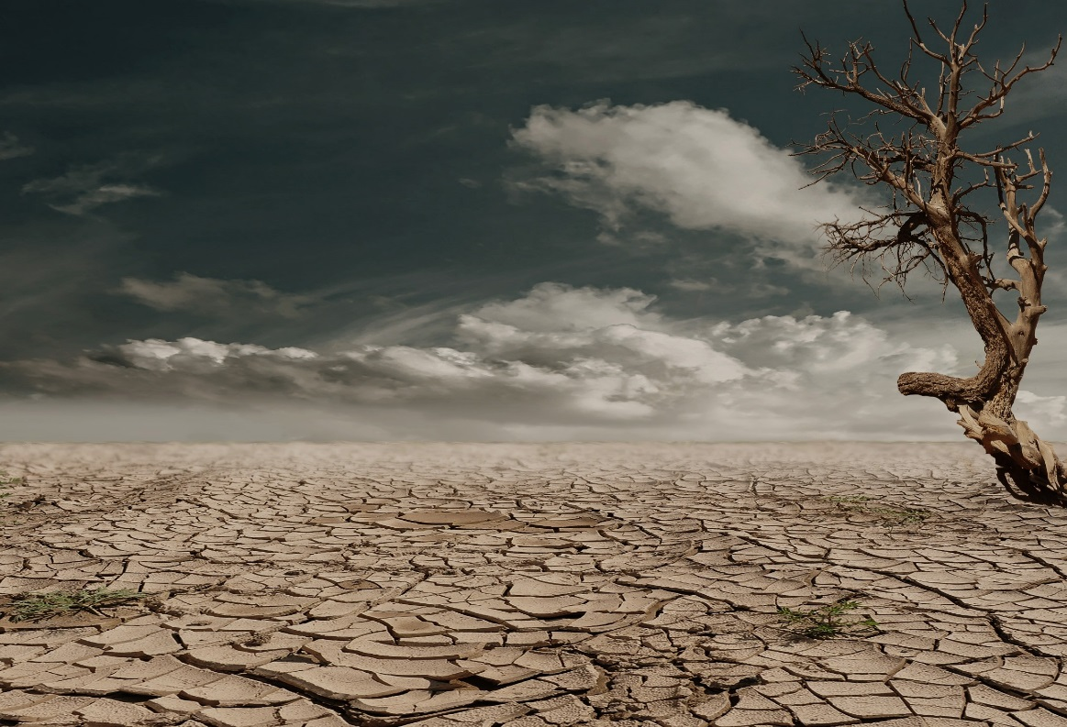

The Link: Energy and Extreme Weather
Global warming:
More heat
⇓
More drying
⇓
More evaporation
⇓
More moisture
in clouds
4% per °F
7% per °C
More drought & more floods
Notes:
at risk, including parts of Mexico.

Slide 8
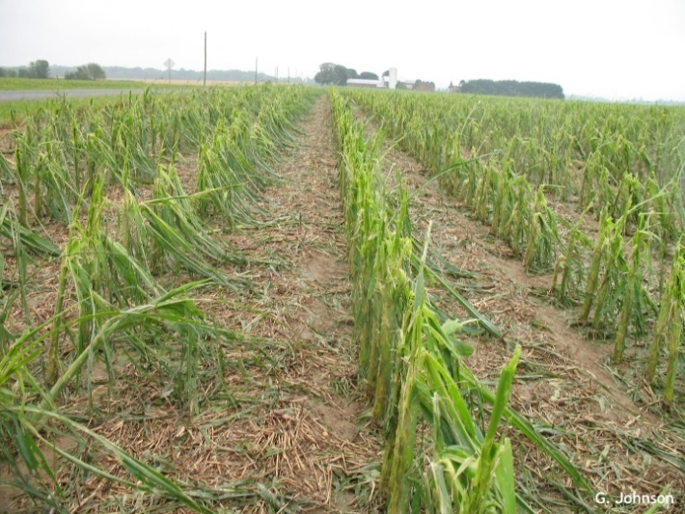
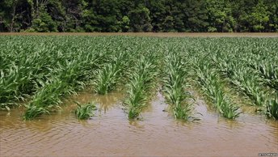
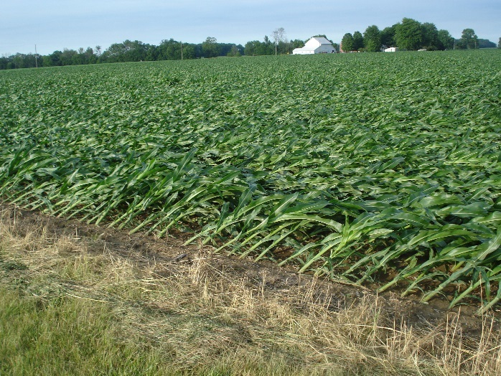
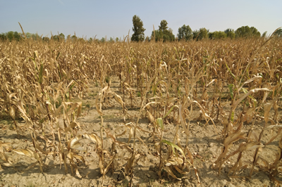
The Impact: Extreme Weather Damage on Agriculture
Hail
Flood
Wind
More extreme weather events & increased variability
Drought

Slide 9
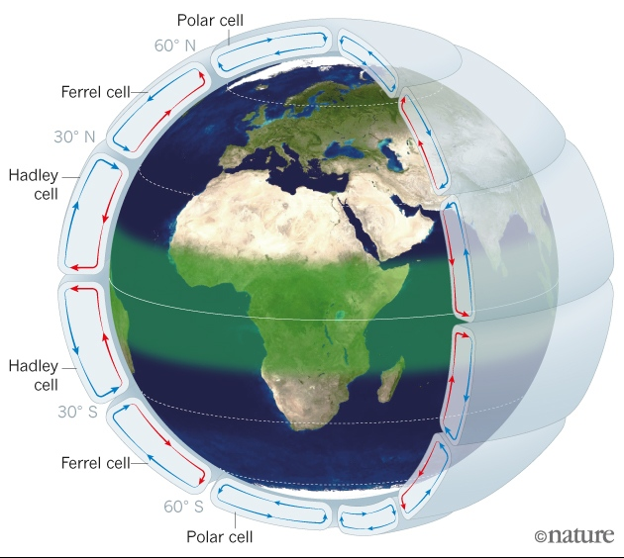
The Link: Energy & Changing Weather Patterns
Thermodynamic Foundations of the Earth System
Delves into the fundamental thinking of the physics of our atmosphere
Expansion of the Hadley cell pushes descending air poleward

Slide 10
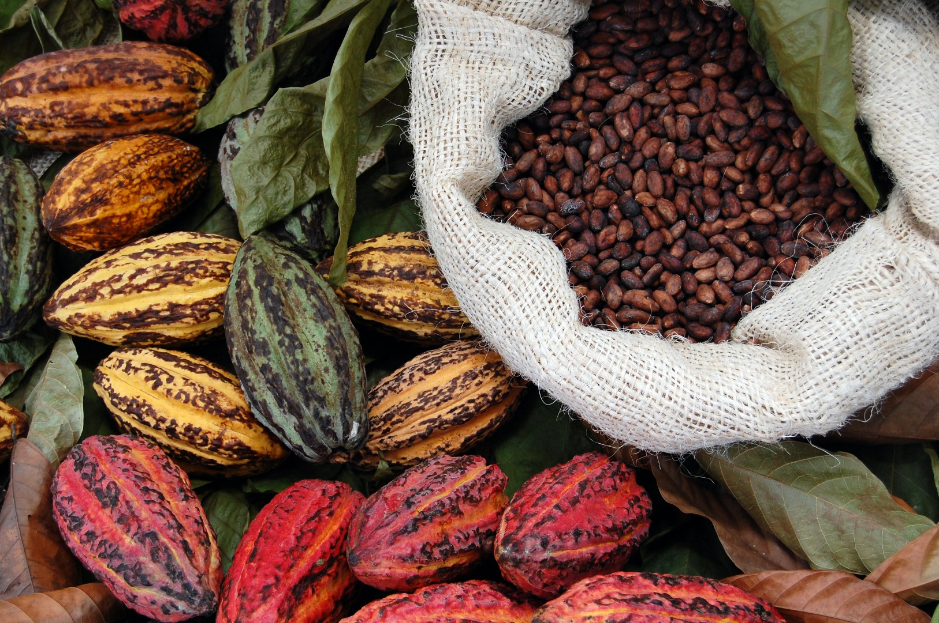
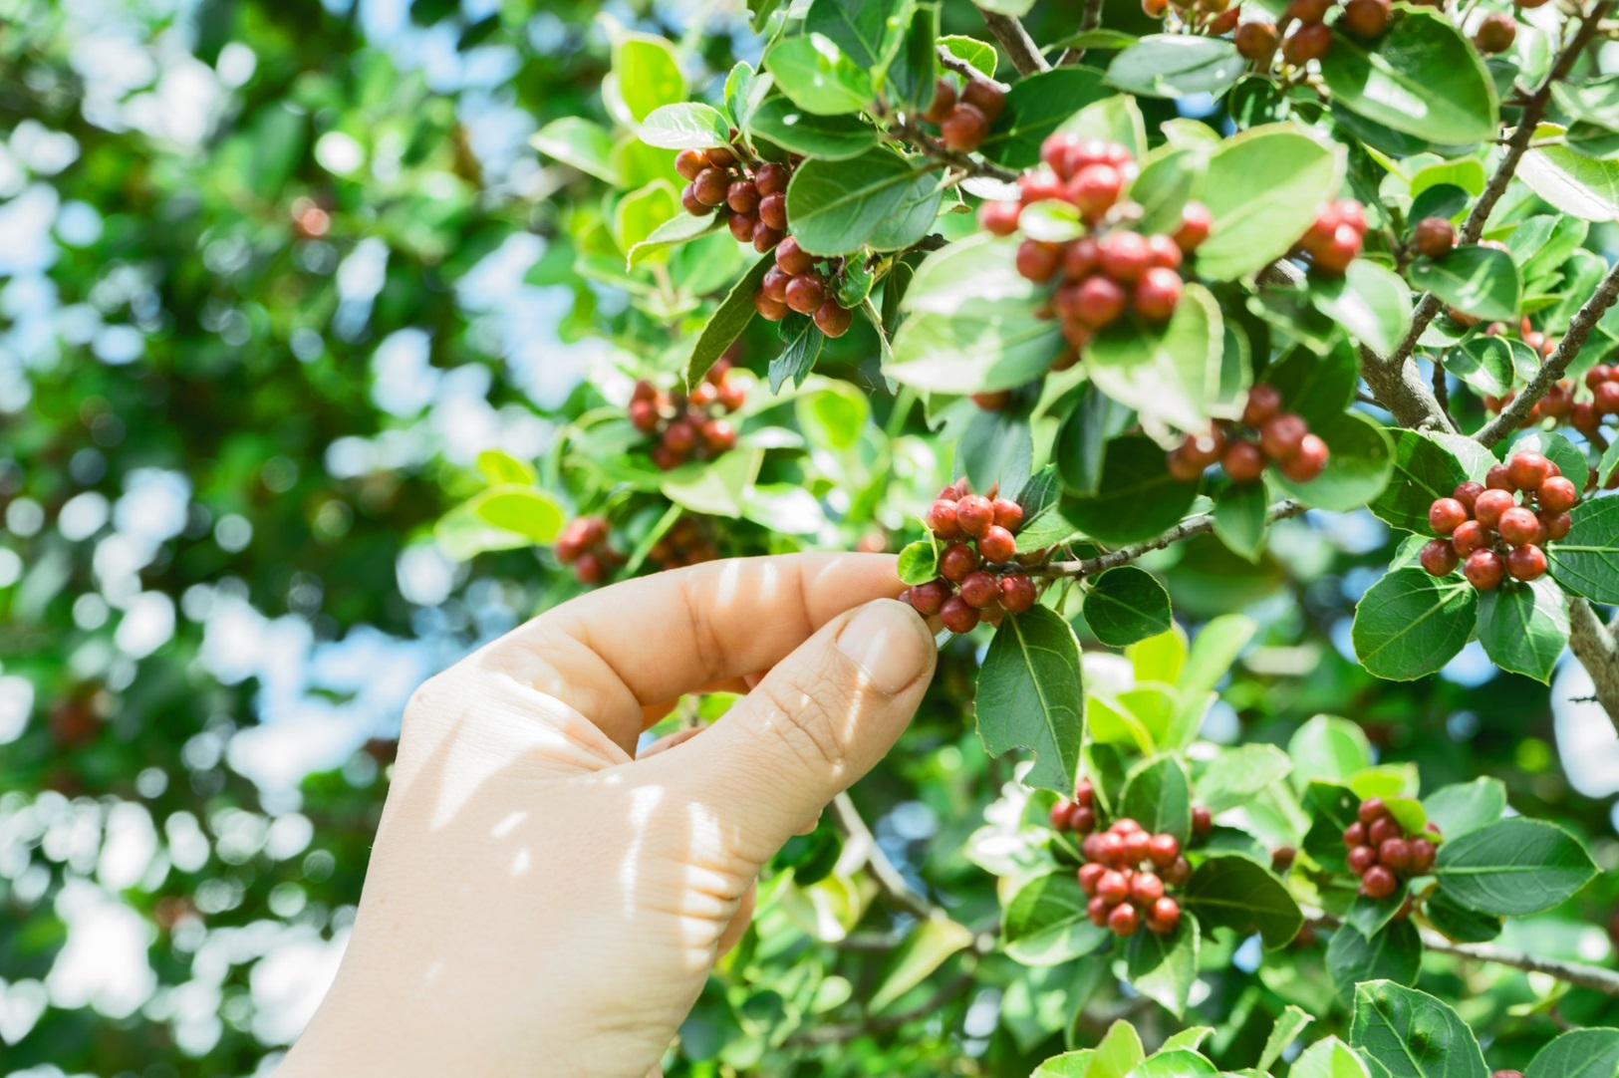
The Impact: Less Predictability & Security
Cacao
Coffee

Slide 11
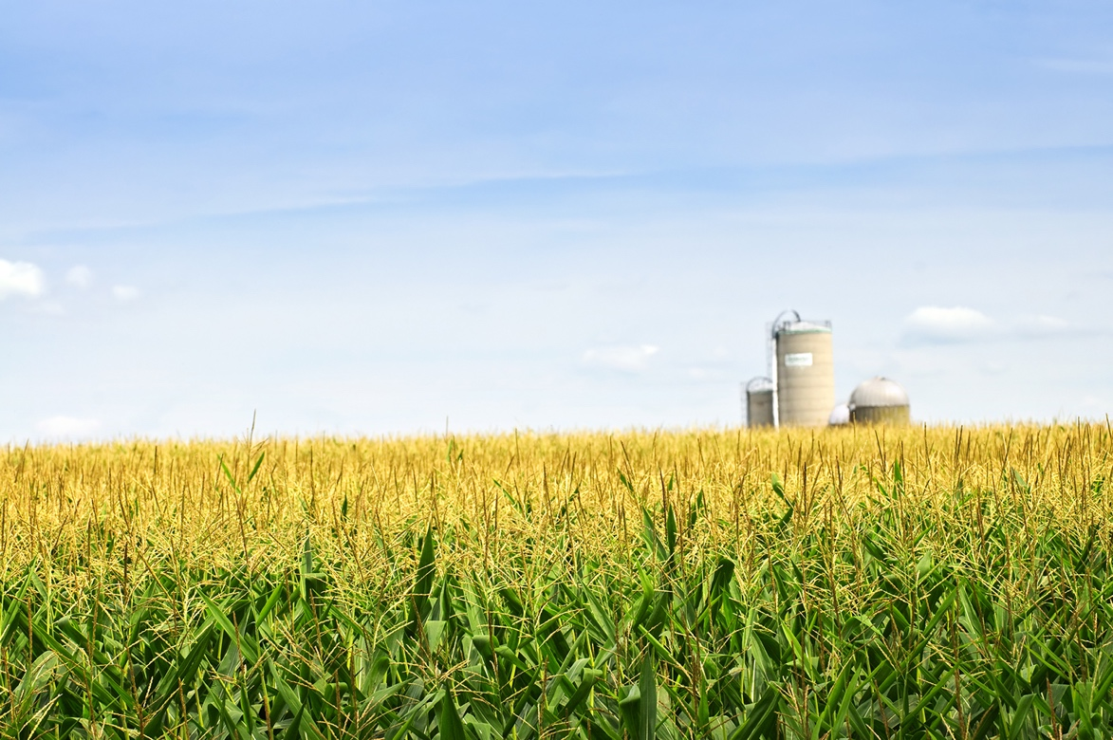
An agriculture intelligence company
Providing the most complete agriculture-weather data
and insight for real-time agricultural decisions globally

Slide 12

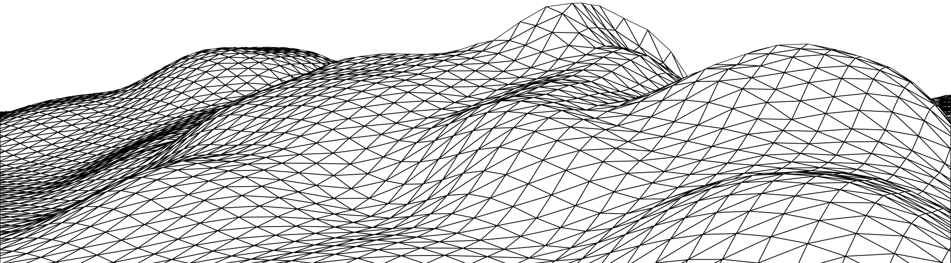

Using advanced 3D interpolation, aWhere creates a continuous surface of weather attributes, a virtual weather stations in between physical ones.
Eliminates the need to deploy array’s of expensive stations
Capable of ingesting existing ‘personal’ stations
Excludes problem stations day-by-day
Highly accurate for driving agricultural decisions

Slide 13


To monitor the weather, aWhere constructs virtual weather stations every 9km across the planet
Satellite Radar
17%
35%
Weather Station
38%
Ground Radar
Field
5%
28%
15%
Temperature, Humidity etc.
Precipitation
24%
17%
C
21%
C
C

Slide 14
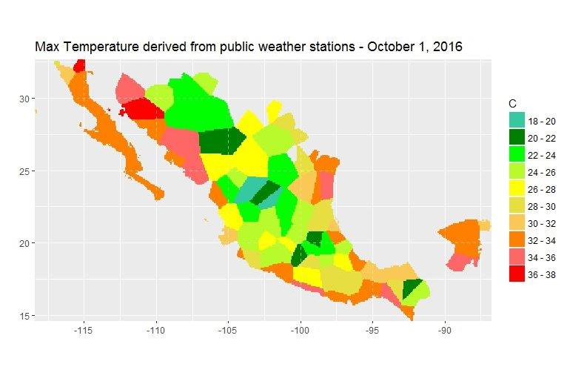
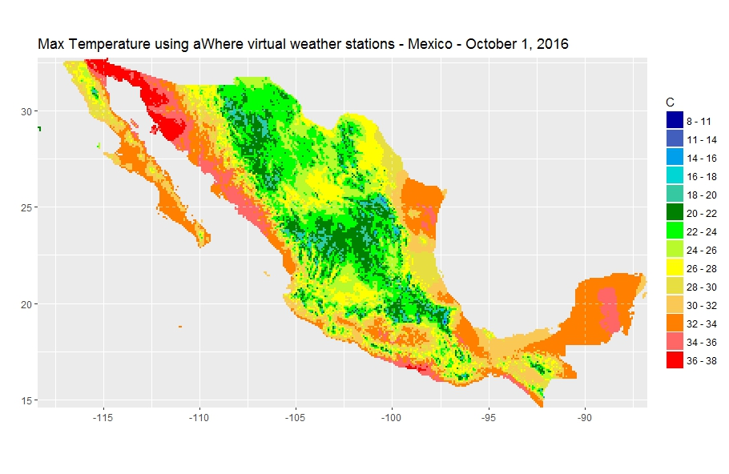
More Specific Data = Better Information
Relying on inferior data results in incorrect decisions
More specific information gives more clarity
Mexico
Free and Premium Providers
103 Data Points
Mexico
aWhere Data
25,000 Data Points

Slide 15
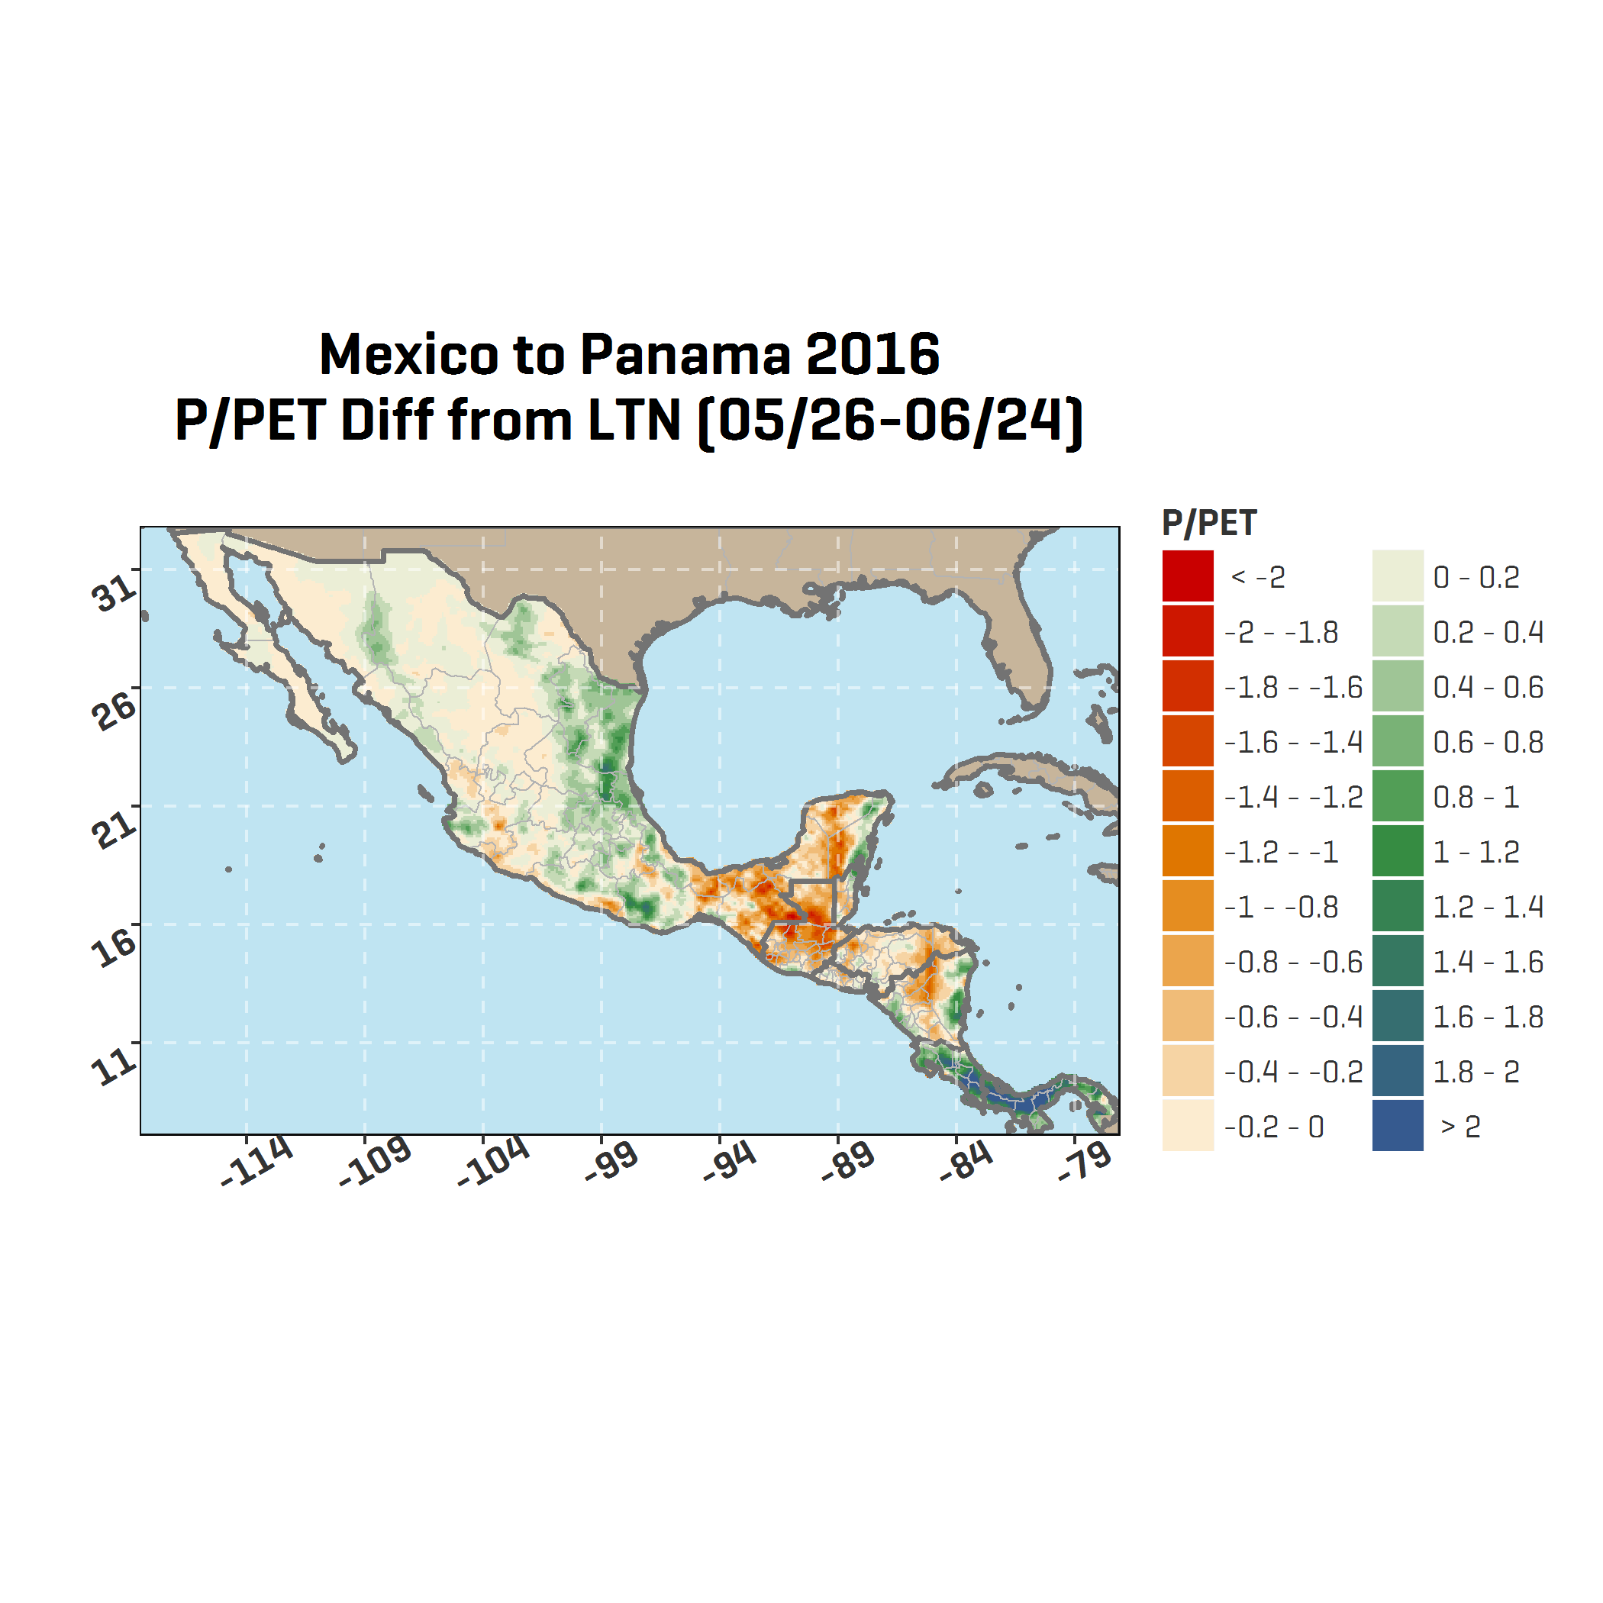
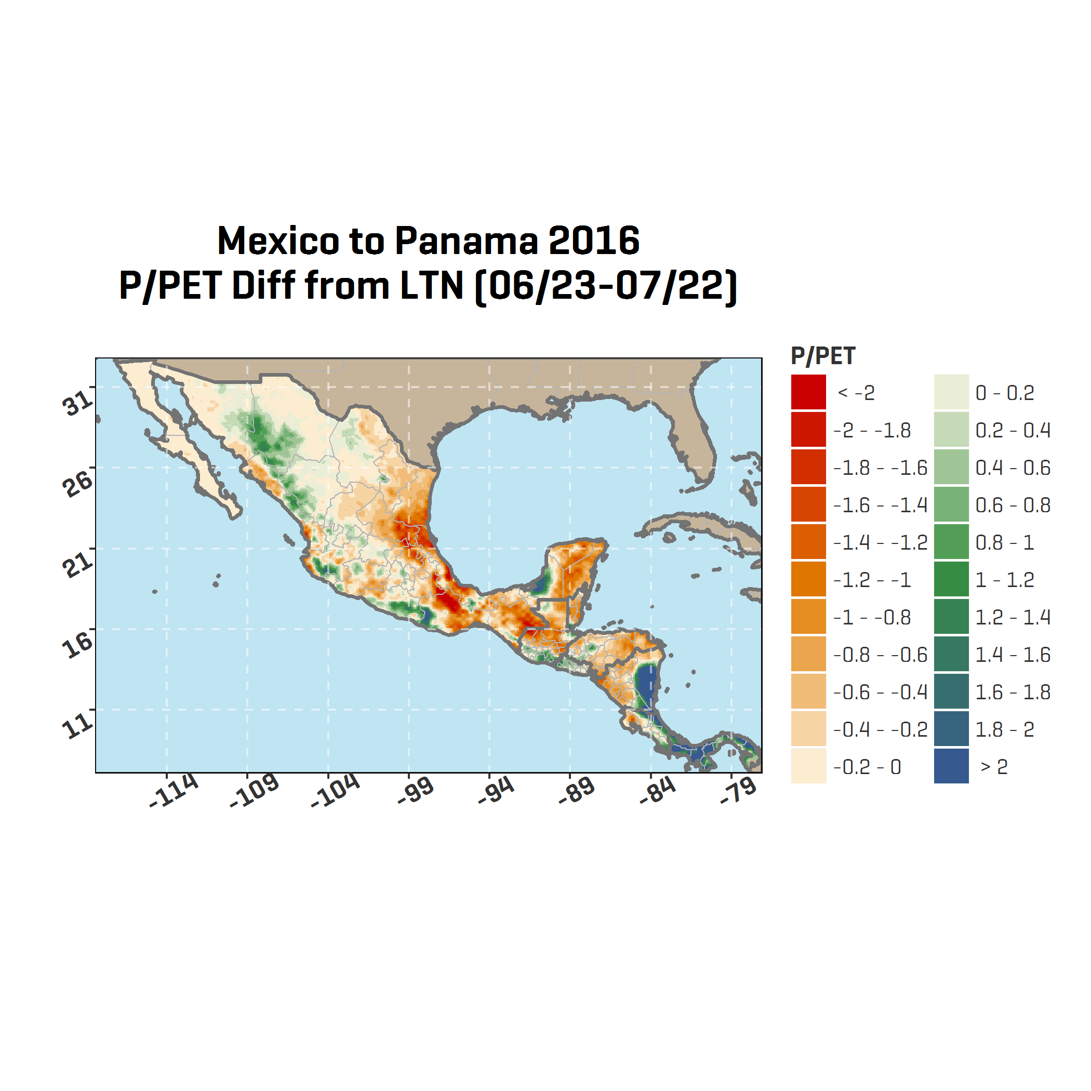
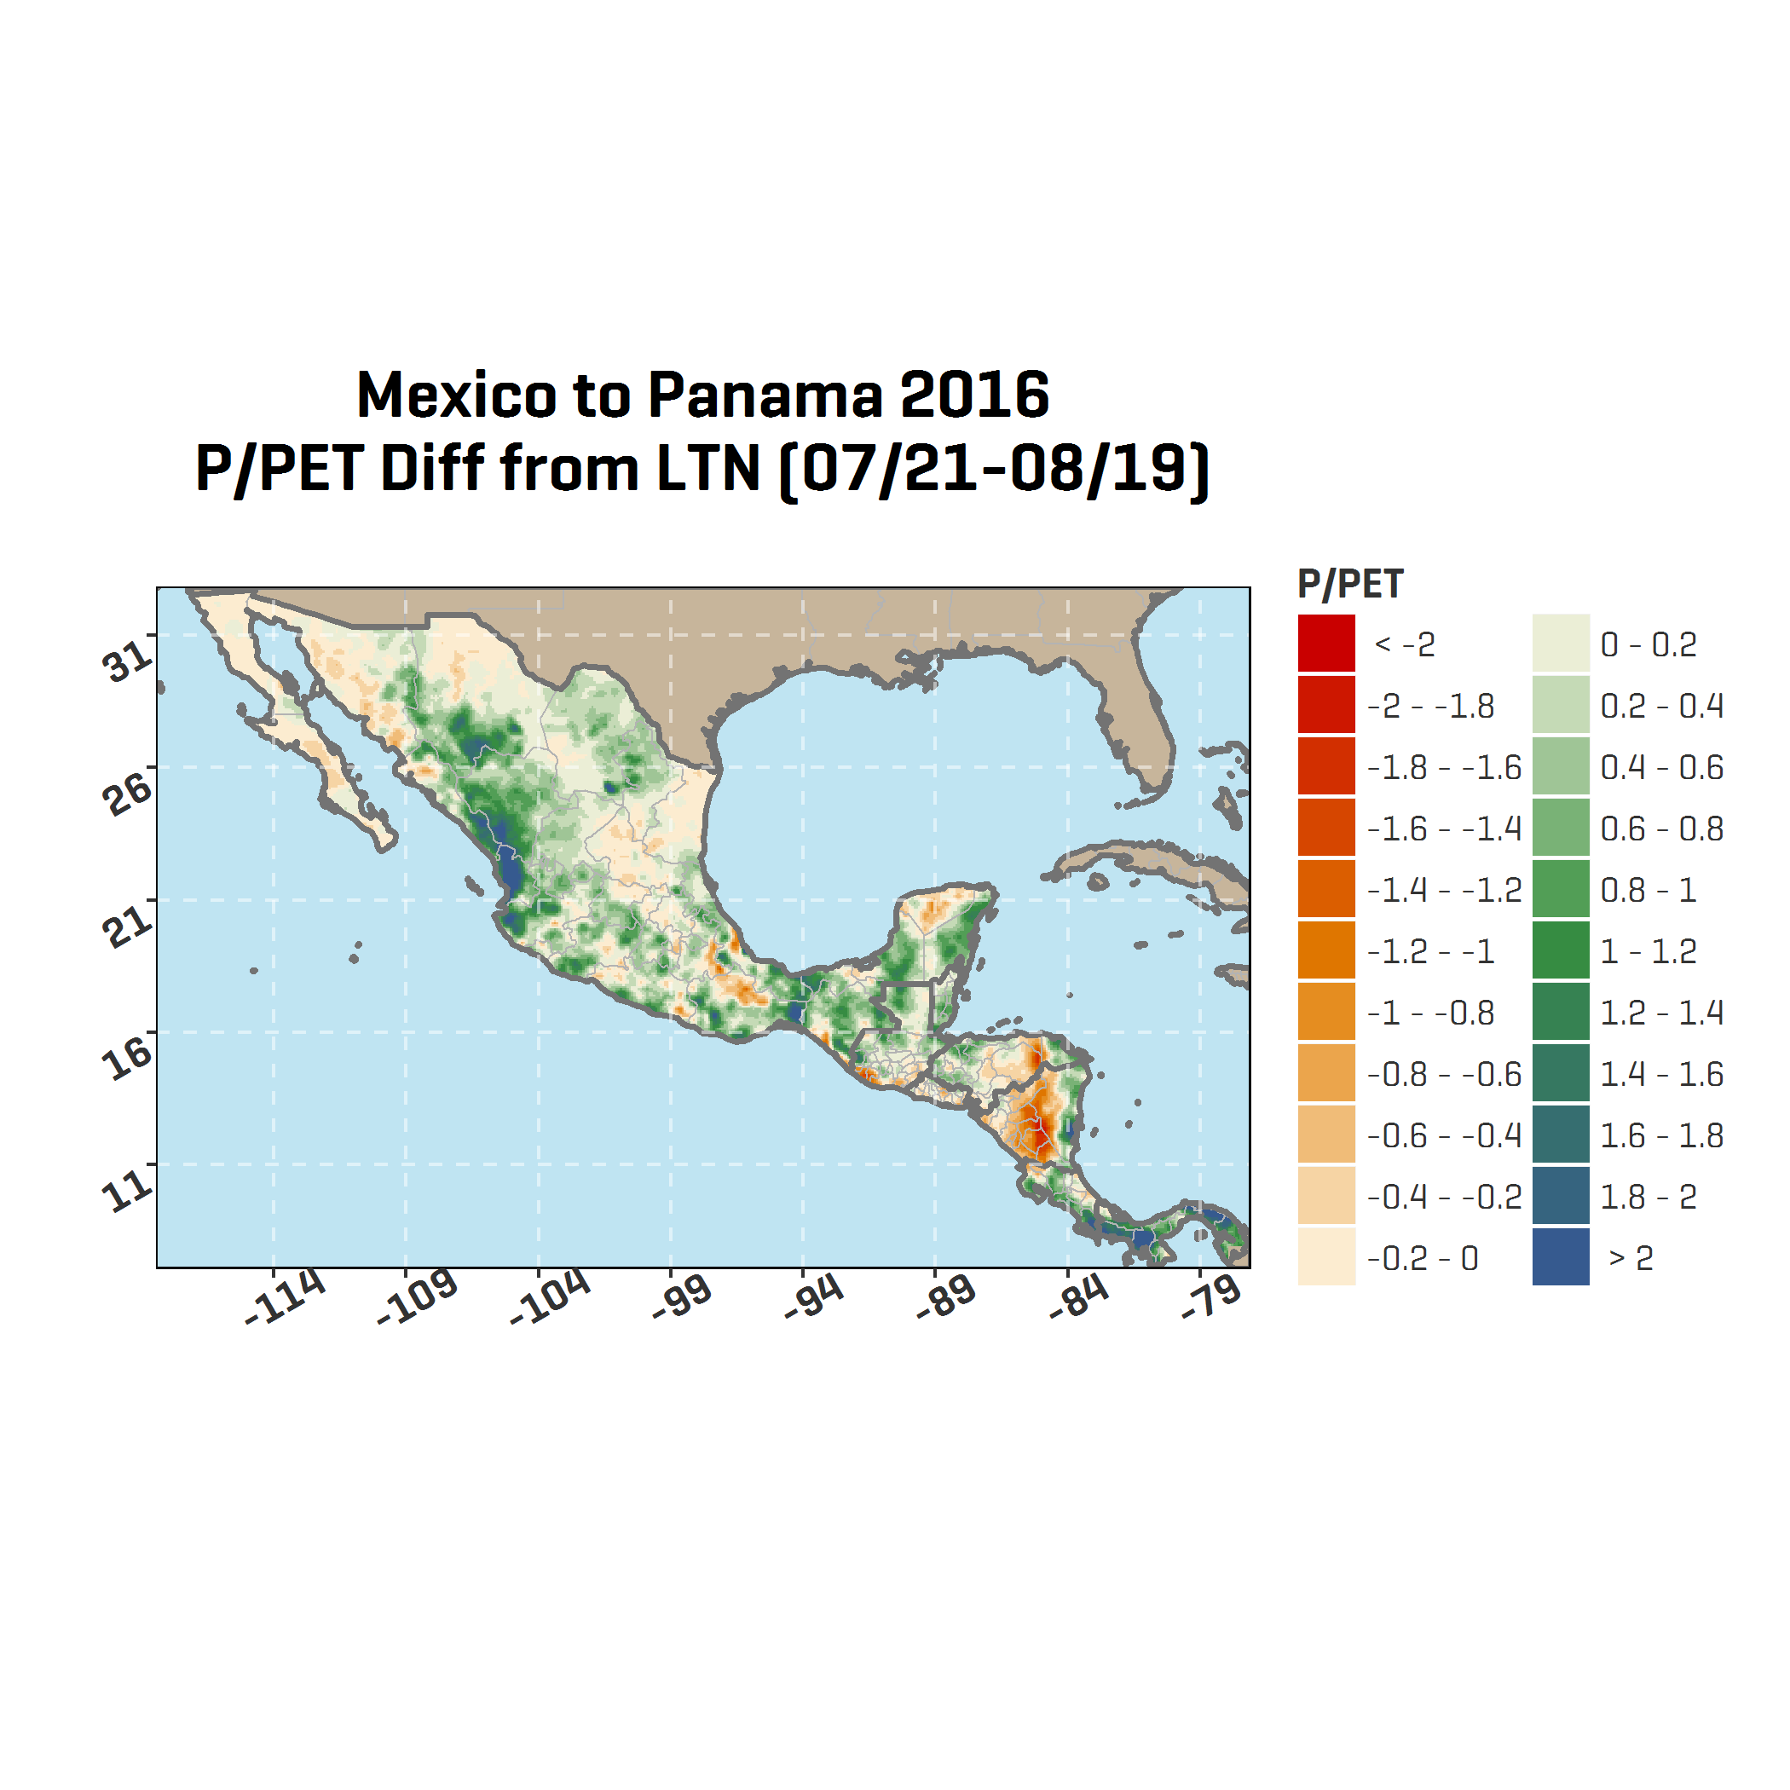
Pocket Droughts: P/PET compared to Long-Term Norms
May 26 – June 24 2016
June 23 – July 22 2016
July 21 – August 19 2016
Comparing P/PET to the long term normal is a simple yet highly interpretable water stress indicator.
Drier than normal conditions always have a negative impact.

Slide 16
In a world with a more energetic atmosphere
Expect Increasing
Rain variability
Temperatures
Insect and disease pressure
Pocket droughts
Seasonal shifts
What we need:
Adaptive, Agile Agriculture

Slide 17
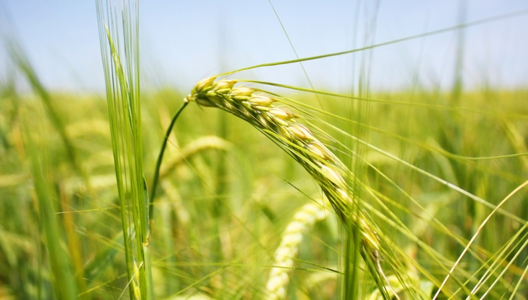

Denver, CO
awhere.com
303-279-9293
Leila Al-Hamodah
Client Engagement Manager
leilaalhamoodah@awhere.com
©2016 aWhere, Inc. Customer logos copyrighted by their respective owners. Some images licensed under Creative Commons courtesy NOAA, Ladd Observatory, Stephen Bowler

